Slide 1
Importance of emission accounting
Greenhouse-gas emissions from the energy sector represent roughly two-thirds of all anthropogenic greenhouse-gas emissions.
Representatives from 195 nations at the COP21 in Paris agreed on a long-term goal to keep the global average temperature increase well below 2ºC.
There is a need for a transition to a low carbon economy to achieve this.
Emissions of other pollutants, such as NOx, SO2 and PM, which adversely affect health public health and the environment can be monitored and reduced.
Notes:
Source of quote on 2/3 of GHG emissions coming from energy sector: https://www.iea.org/publications/freepublications/publication/WEO2015SpecialReportonEnergyandClimateChange.pdf

Slide 2
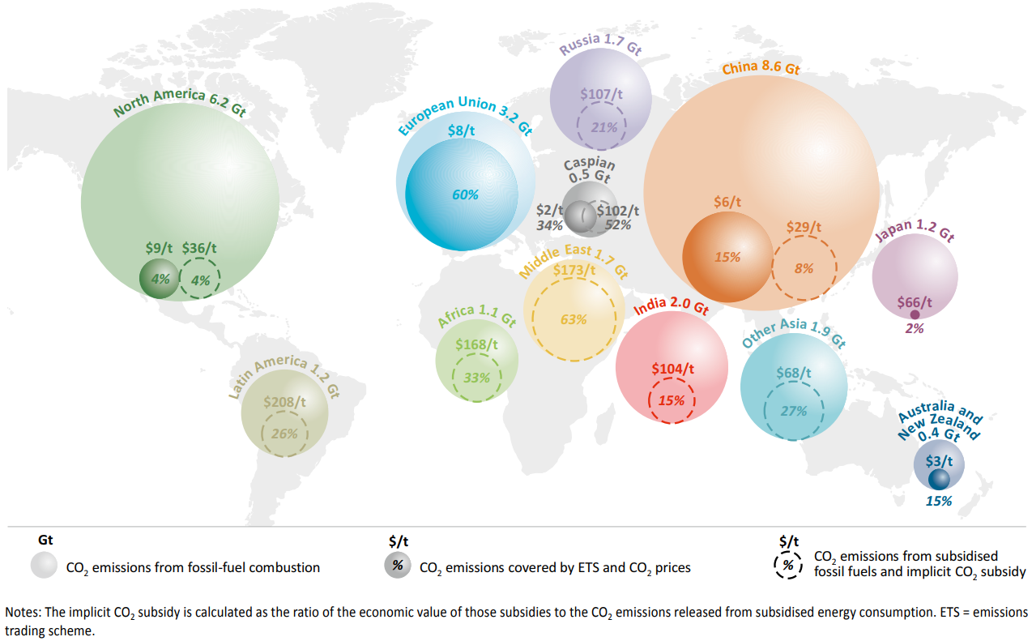
Source: IEA WEO 2015
Notes:
Source of image: https://www.iea.org/publications/freepublications/publication/WEO2015SpecialReportonEnergyandClimateChange.pdf

